Slide 1

NS-3 Network Project
By / Ahmed Hassanen
ID / 19

Slide 2
AGENDA
LAN Structure
LIBRARES
MAIN Function
Creating Nodes
Setup LAN
Setup P2P
IP Addressing
Creating Apps
OUTPUTS

Slide 3
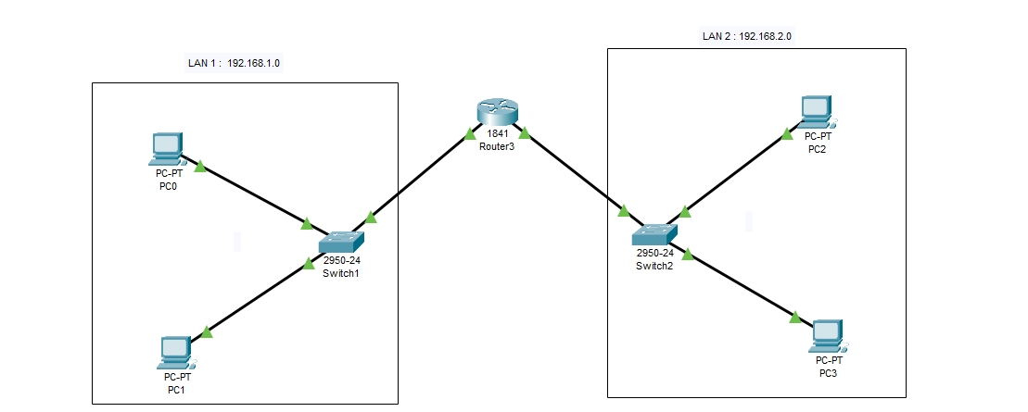
LAN Structure

Slide 4
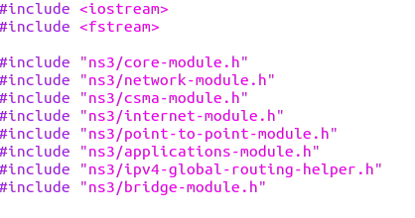
LIBRARIES
Setup LAN
Creating Nodes
Main Function
We include some libraries for Network and Channel properties
The most important library is : - Csma : library for Ethernet Channel
IPv4 : library for getting IP for nodes
bridge : library for switches

Slide 5
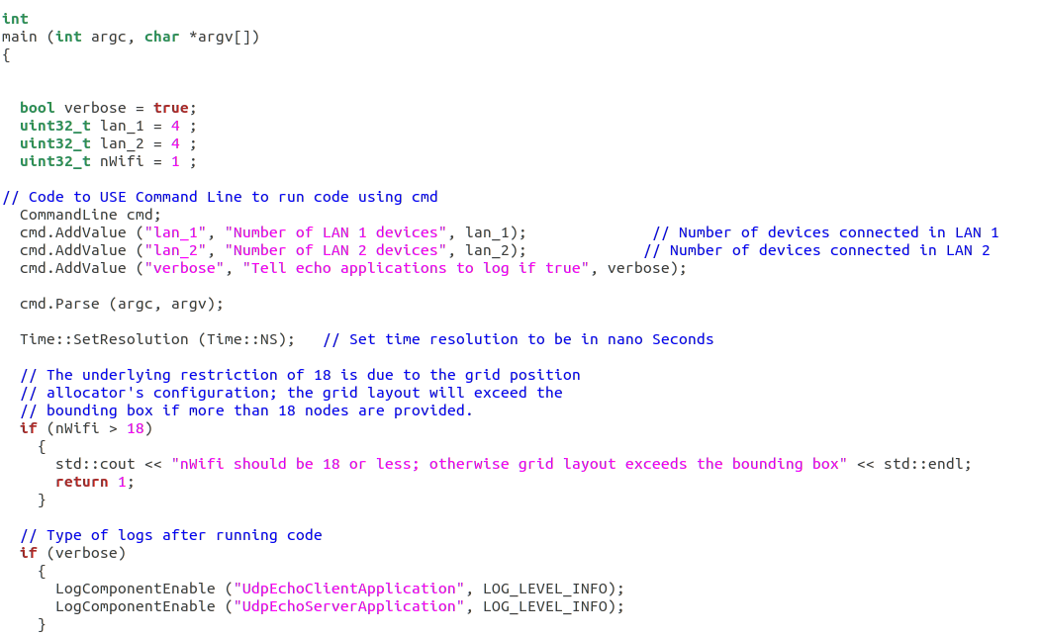
LIBRARIES
Main Function
Setup LAN
Creating Nodes
LIBRARIES
In this part we introduce the main library , then get three variables lan_1 , lan_2 and nWifi to get number of nodes in network programing code to be worked in cmd and get time resolution in ns

Slide 6
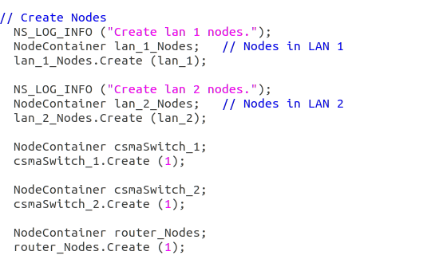
Creating Nodes
Setup LAN
LIBRARIES
Main Function
In this part we create nodes :
Number of ( lan_1 ) in LAN 1 Network
Number of ( lan_2 ) in LAN 2 Network
Two Switches in csmaSwitch variable
One router

Slide 7
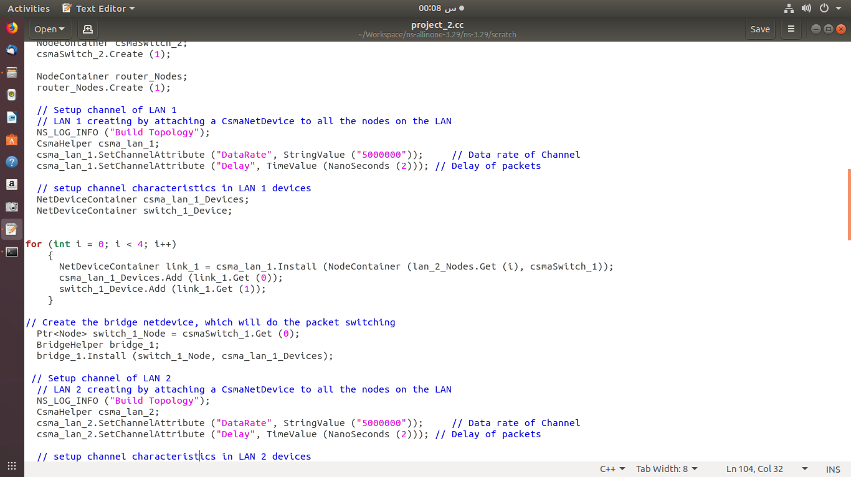
Setup LAN
- Number of ( lan_1 ) in LAN 1 Network
- Number of ( lan_1 ) in LAN 1 Network
- Number of ( lan_1 ) in LAN 1 Network
Setup P2P
LIBRARIES
Main Function
Creating Nodes
In this part we Setup LAN :
Creating CSMA channel using csmaHelper with data rate 5M bps and delay time 2 ns
Setup characteristics between device to make connections between devices
Using BridgeHelper to connect devices to switches

Slide 8
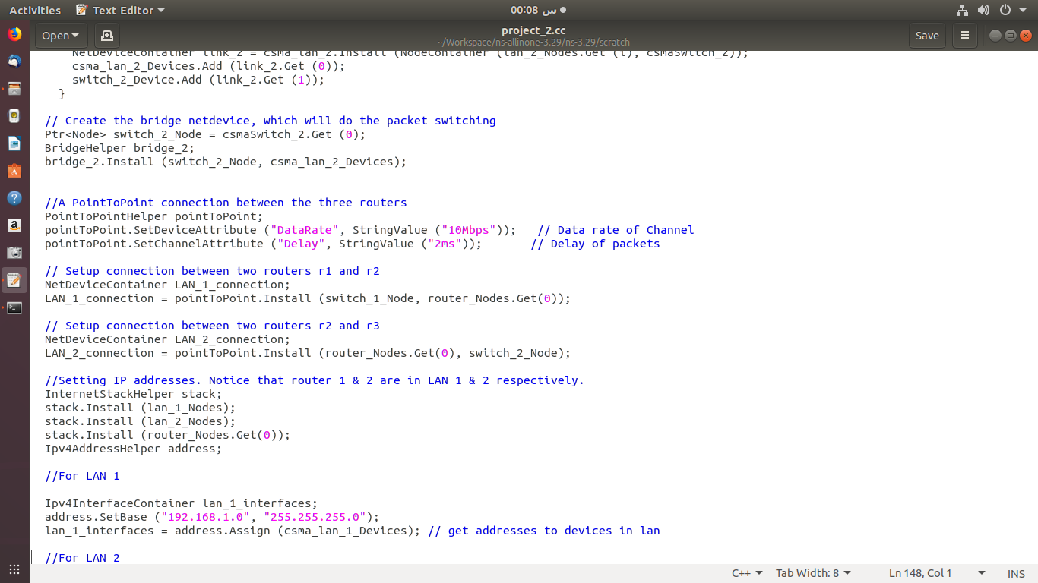
Setup P2P
- Number of ( lan_1 ) in LAN 1 Network
- Number of ( lan_1 ) in LAN 1 Network
- Number of ( lan_1 ) in LAN 1 Network
IP Addressing
Setup LAN
LIBRARIES
Main Function
Creating Nodes
In this part we Setup Point to Point channel :
Creating P2P channel using PointToPointHelper with data rate 10Mbps and delay time 2 ms
Creating LAN Connections between router and Switches

Slide 9
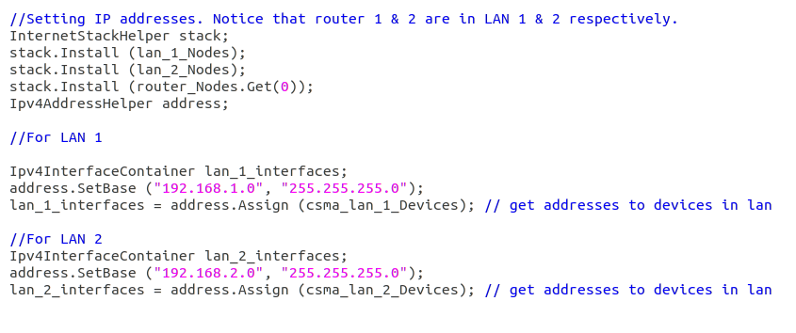
IP Addressing
- Number of ( lan_1 ) in LAN 1 Network
- Number of ( lan_1 ) in LAN 1 Network
- Number of ( lan_1 ) in LAN 1 Network
- Number of ( lan_1 ) in LAN 1 Network
Setup P2P
Setup LAN
Creating Apps
Main Function
Creating Nodes
In this part we getting IP addresses for devices in Network using Ipv4AddressHelper :
Getting IP 192.168.1.0 and 255.255.255.0 to LAN 1
Getting IP 192.168.2.0 and 255.255.255.0 to LAN 1

Slide 10
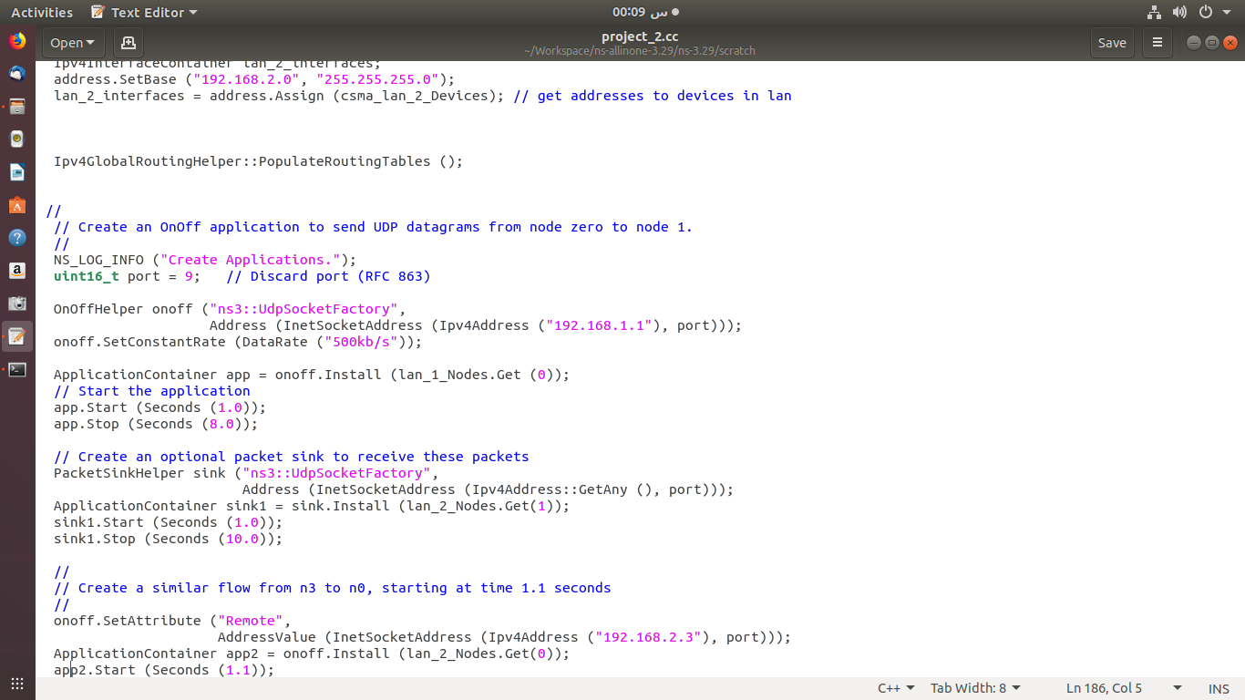
Creating Apps
- Number of ( lan_1 ) in LAN 1 Network
- Number of ( lan_1 ) in LAN 1 Network
- Number of ( lan_1 ) in LAN 1 Network
- Number of ( lan_1 ) in LAN 1 Network
- Number of ( lan_1 ) in LAN 1 Network
IP Addressing
Setup P2P
Setup LAN
OUTPUTS
In this part we creating Two apps to send packets by port 9
Application 1 to send packet from device 1 in LAN 1 to device 2 in LAN 2 starts in second 1
Application 2 to send packet from device 1 in LAN 2 to device 2 in LAN 1 starts in second 1.1

Slide 11
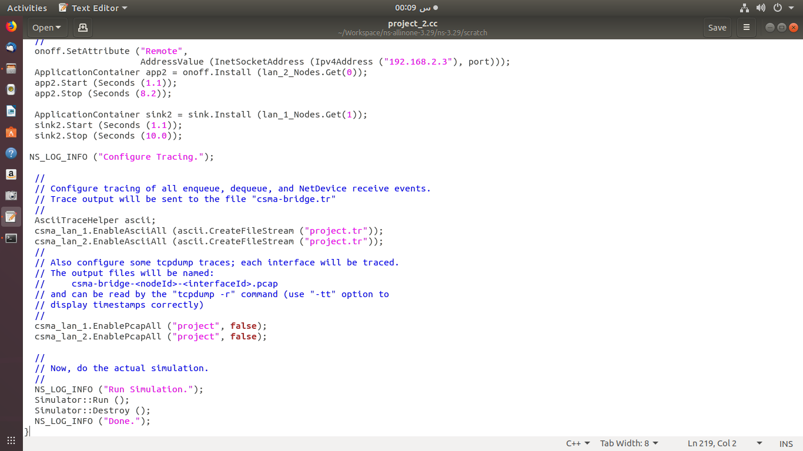
OUTPUTS
- Number of ( lan_1 ) in LAN 1 Network
- Number of ( lan_1 ) in LAN 1 Network
- Number of ( lan_1 ) in LAN 1 Network
- Number of ( lan_1 ) in LAN 1 Network
Creating Apps
IP Addressing
Setup P2P
In this part create files to get outputs in files

